Slide 1
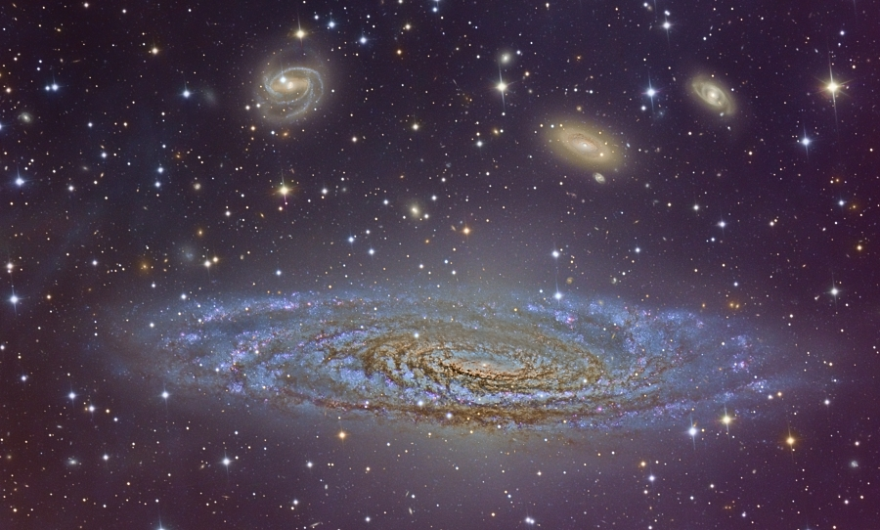
NGC 7331 Galaxy

Slide 2
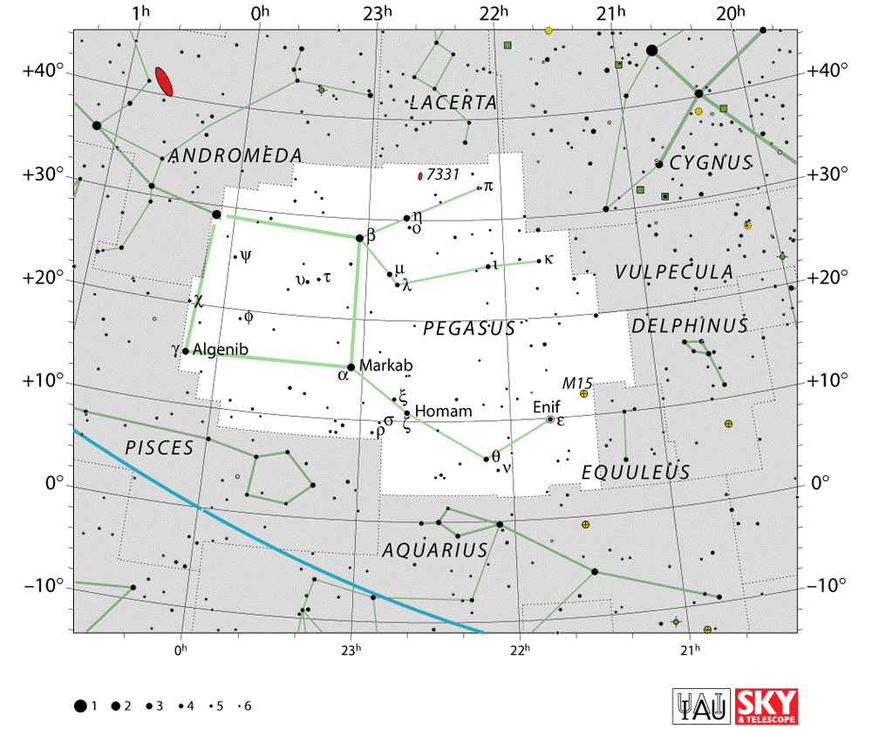

Slide 3
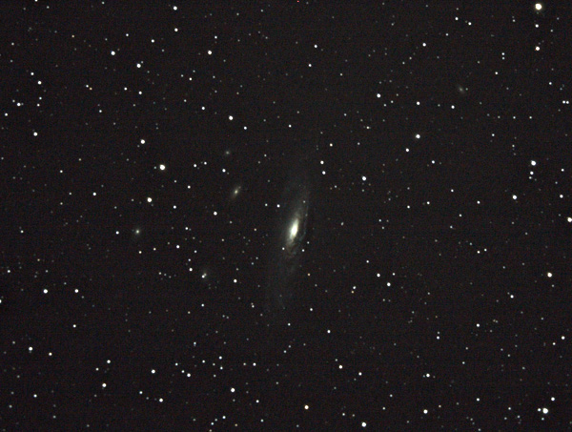
Constellation | Pegasus
Right ascension | 22h 37m 04.1
Declination | +34° 24′ 56″]
Redshift | 816 ± 1 km
Distance | 40 ± 3 e6ly (12.2 ± 1.0 Mpc)
Apparent magnitude (V) | +10.4
Type | SA(s)
Apparent size (V) | 10′.5 × 3′.7
NGC 7331

Slide 4
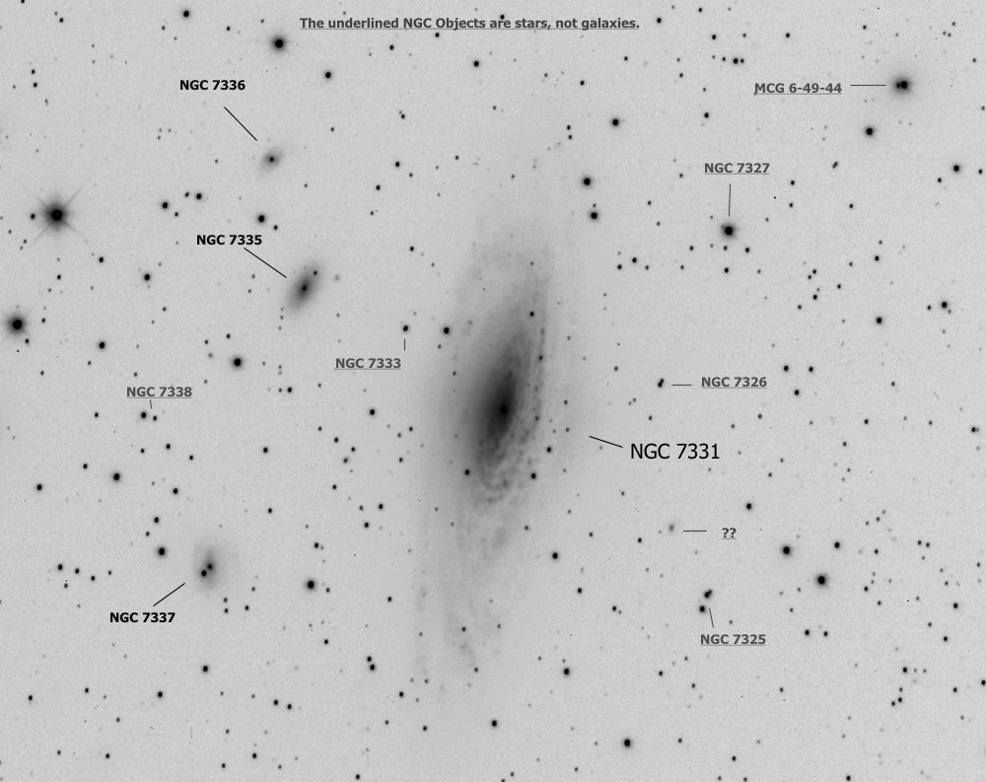
NGC 7331 is a unbarred spiral galaxy about 40 million light-years away in the constellation Pegasus. It was discovered by William Herschel in 1784. NGC 7331 is the brightest member of the NGC 7331 Group of galaxies

Slide 5
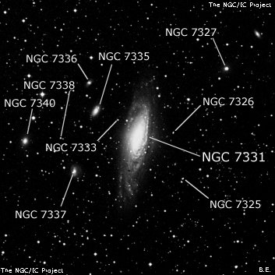

Slide 6
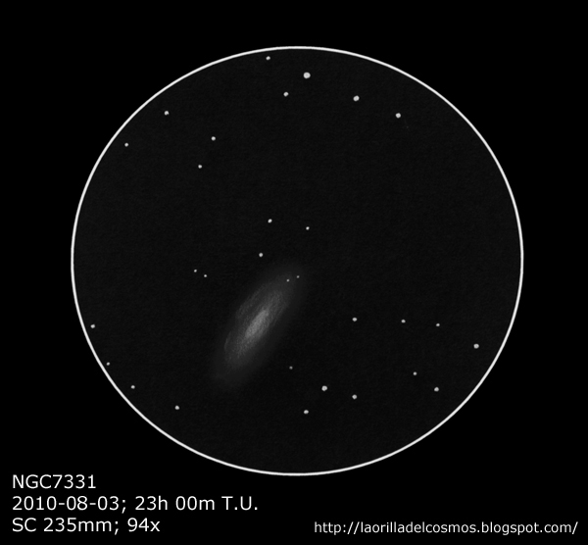
NGC 7331 as it appears in
small Telescopes at
94 power

Slide 7
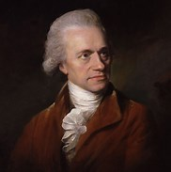
NGC 7331 is an unbarred spiral galaxy about 40 million light-years
away in the constellation Pegasus. It was discovered by William Herschel
in 1784.
William Herschel, original name Friedrich Wilhelm Herschel
(born Nov. 15, 1738, Hannover, Hanover—died Aug. 25, 1822,
Slough, Buckinghamshire, Eng.) German-born British astronomer, the
founder of sidereal astronomy for the systematic observation of the
heavens. He discovered the planet Uranus, hypothesized that nebulae
are composed of stars, and developed a theory of stellar evolution.

Slide 8
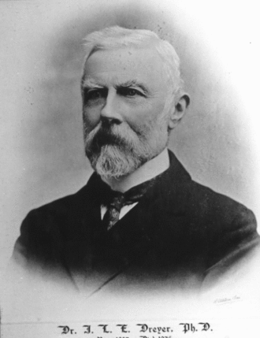
The New General Catalogue of Nebulae and Clusters of Stars (abbreviated as NGC)
is a well-known catalogue of deep-sky objects compiled by John Louis Emil Dreyer in 1888 as a new
version of John Herschel's General Catalogue of Nebulae and Clusters of Stars. The NGC contains
7,840 objects, known as the NGC objects. It is one of the largest comprehensive catalogues, as it
includes all types of deep space objects and is not confined to, for example, galaxies.
Dreyer also published two supplements to the NGC in 1895 and 1908, known as the
Index Catalogues, describing a further 5,386 astronomical objects.
John Louis Emil Dreyer
(February 13, 1852 – September 14, 1926)
was a Danish-Irish astronomer

